Slide 1
.
Converting Agri Waste into Green Energy & Organic Fertilizers
Vision:
To reduce the carbon footprint , manage the agricultural waste and primary cell waste.
To create a market for farmers to sale the agricultural waste .
Team Hemta
Innovators
PRIYAM JYOTI DAS
JOYBIKASH NEOG

Slide 2

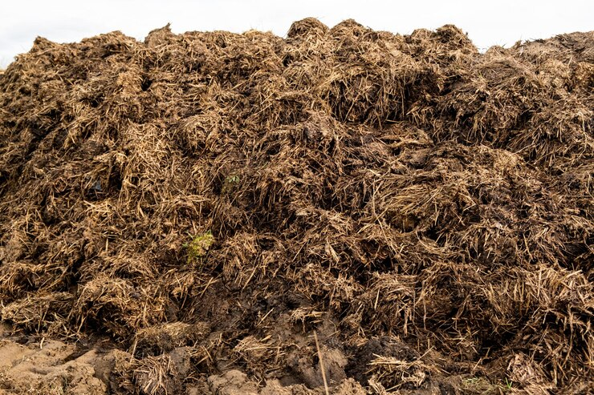
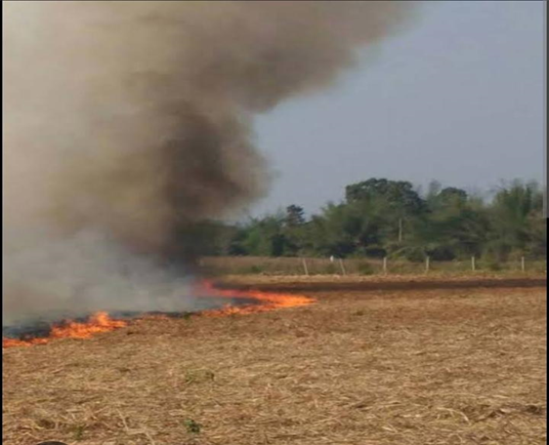

We have a Problem…
350
Million tons of agriculture
waste is produced per year
in India.
90%
Of agricultural waste is
Burned in open atmosphere
every year.
70%
Of farmers prefer to burn
agricultural waste.
The natural decomposition technique requires
more time. So the farmers avoid natural
decomposition technique and prefer to burn
the agricultural waste.
Farmers prefer to burn agricultural waste.
because they do not have any waste manage
-ment system where they can decompose
Their agricultural waste easily in a short
period of time.
The burning of agricultural waste releases
severe pollution that harms the environment
and endangers human health, leading to
diseases such as skin disorders and respiratory
problems.

Slide 3


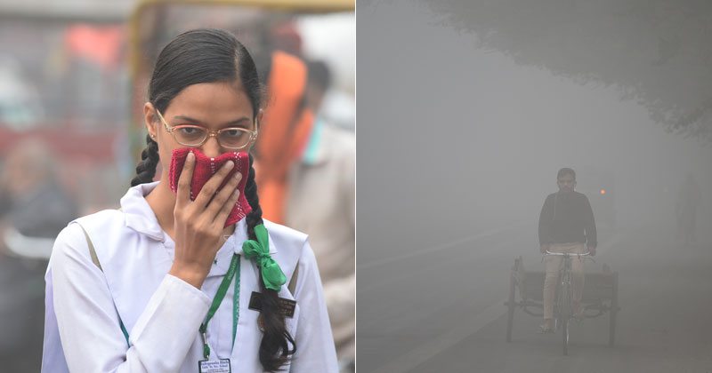
We have a Problem…
agricultural waste burnt cause 45% air pollution
20% agricultural land are affected by agricultural waste burning. Because when the agricultural waste burnt in agricultural field they are reduce the water holding capacity of the land and reduce the microbial activity of the land.
100 millions of people are affected by agricultural waste

Slide 4


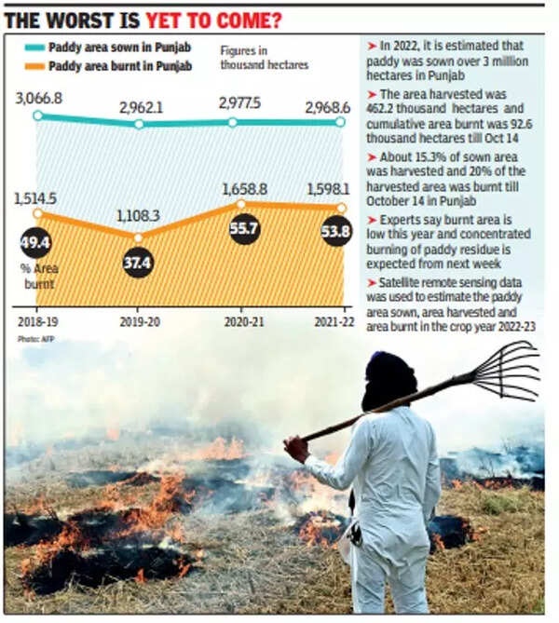
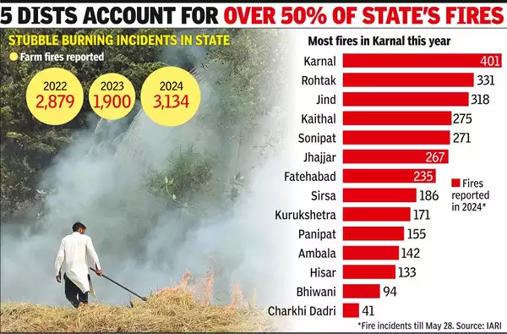
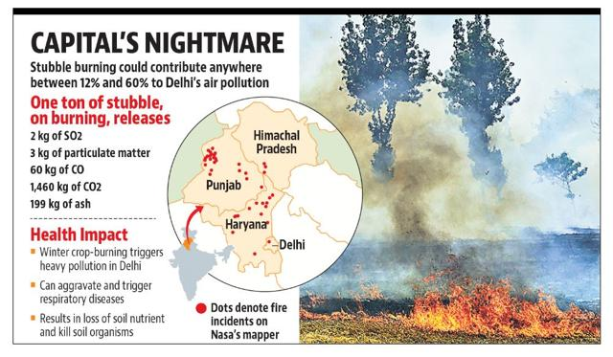
9% groundwater affected from the agricultural waste burn. which are decreases the ground water level.
71 millions farmers are affected by agricultural waste burn.

Slide 5
Our Solution…..
We researched how to prevent this agriculture waste burnt pollution. After research, I learned that we need to use less time-consuming decompose technique and this waste convert into valuable eco-friendly products to prevent this pollution. So,
First, we developed a less time consuming decomposition technique by using of mucor fungi for the farmers.
Secondly, we developed a organic nutrient by using of agricultural waste plant for the proper growth of fungi .
Thirdly, we convert the decompose waste parts into organic liquid and solid fertilizer.
We developed an industrial decomposition technique to produce the bioethanol by using of different agricultural waste.
We developed an eco friendly, long lasting, and easily recyclable battery by using agricultural waste decompose particle as an electrolyte

Slide 6
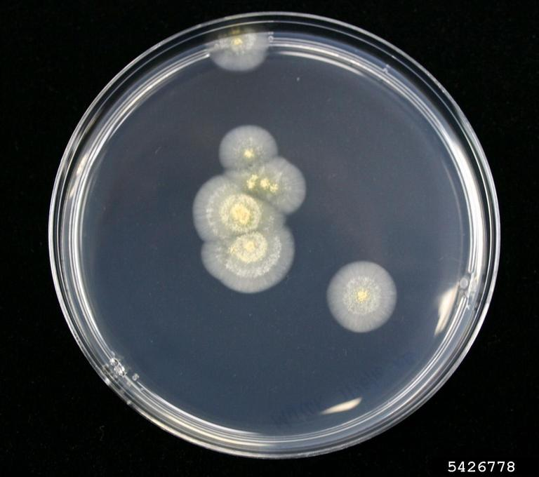
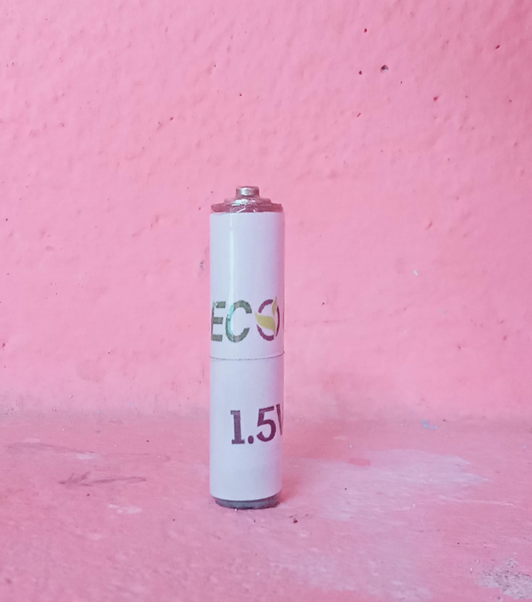
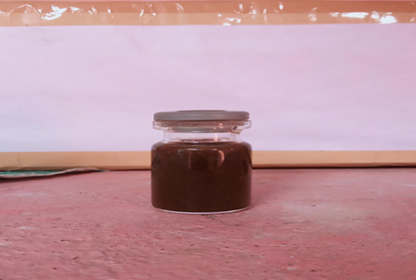






Our Solution…..
100% Eco-friendly
Reduce Air Pollution
Reduce Soil Pollution
Agriculture
Fertilizer Industries
Household
Petroleum Industries
Save Water
Shops
Green Energy

Slide 7
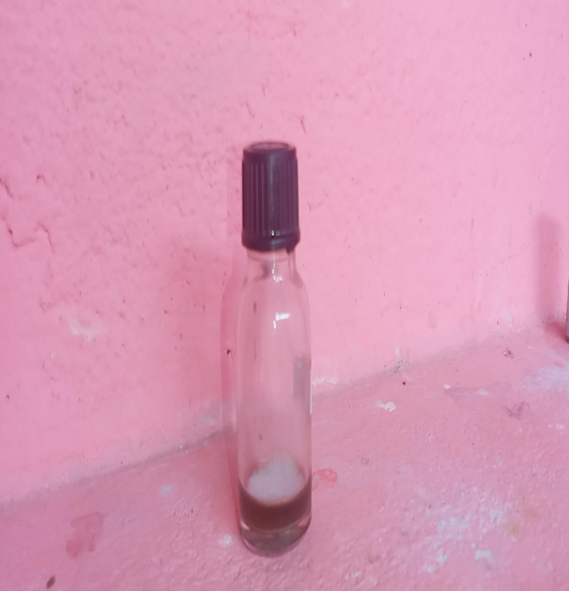
Our Fungus Culture Solution…..
These solution are made from a Specific fungus.
These fungi are of better quality than ordinary mucor fungus as they grow in less time than ordinary mucor fungus and they grow immediately in agri waste and decompose the agri waste in a shorter period of time.
The growth of Mucor fungus can be eliminated with the help of hot water at 100°C.
Fig: Mucor Fugus
Fig: culture solution

Slide 8
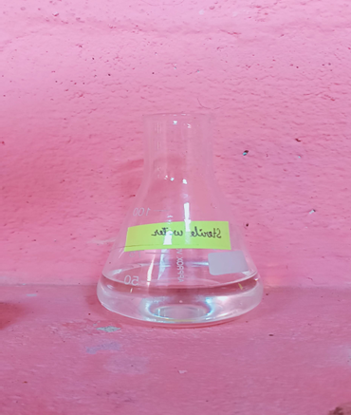
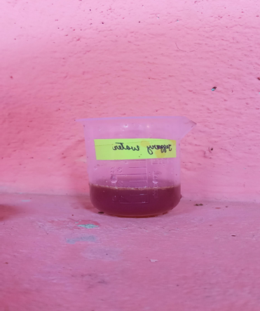
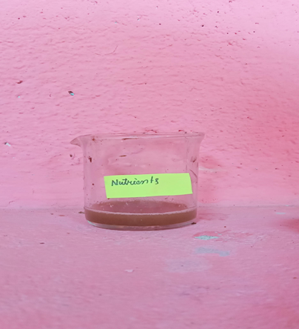
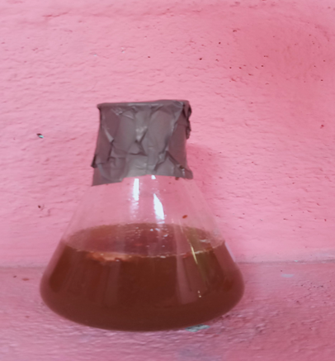
Our Decomposition Technique for Farmer…
Decomposition technique for farmers:
Step 1: Take 2500ml sterile water + 500ml jaggery water + 250 ml nutrients
+ 25ml fungi .
Fig-sterile water
Fig- Jaggery water
Fig- Nutrients
Fig- Fungi culture

Slide 9
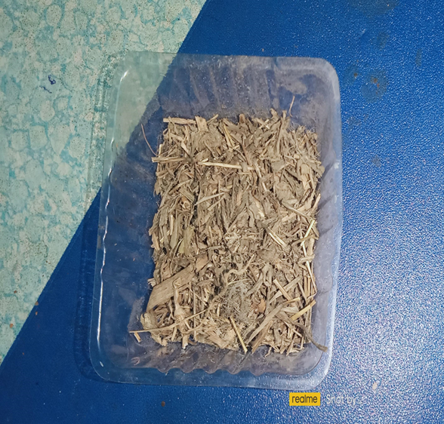
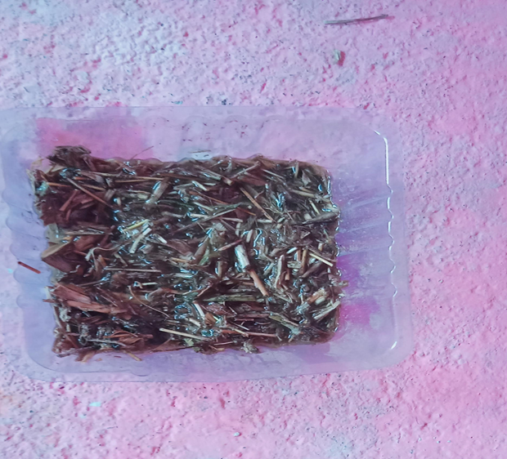
Step 2: After seven days when the culture has grown, it is emulsified once again.
Step 3: Agricultural waste is made into small pieces by grinding.
Step 4: A 10 kg bed of dry Agri waste is made and the culture water is spray on it.
Fig: Mustard oil Plant
Fig: Spray culture water

Slide 10
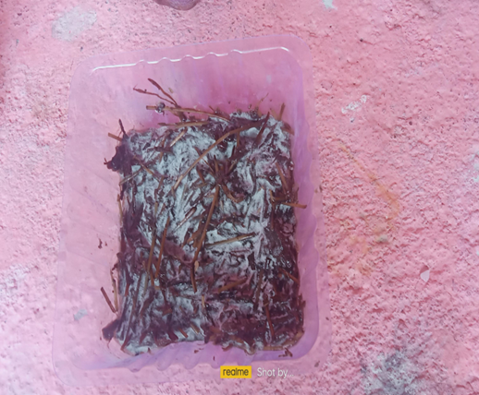
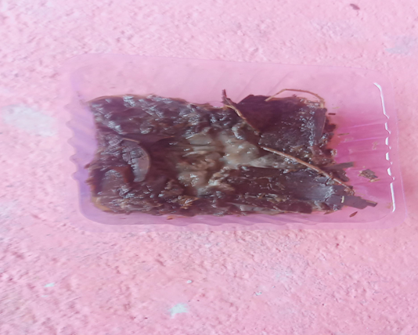
Step 5: dry agri waste Decompose in about 25-45 days, due to fungal culture. (Normally dry Agri waste Decompose in about 5-6 months)
Fig: Decompose agri waste (Rice)
Fig: Decompose agri waste (Banana )
Step 6: The decomposed Agri waste is taken in container and sterilized by spraying
10 litters hot water (100⁰C) while emulsifying.

Slide 11
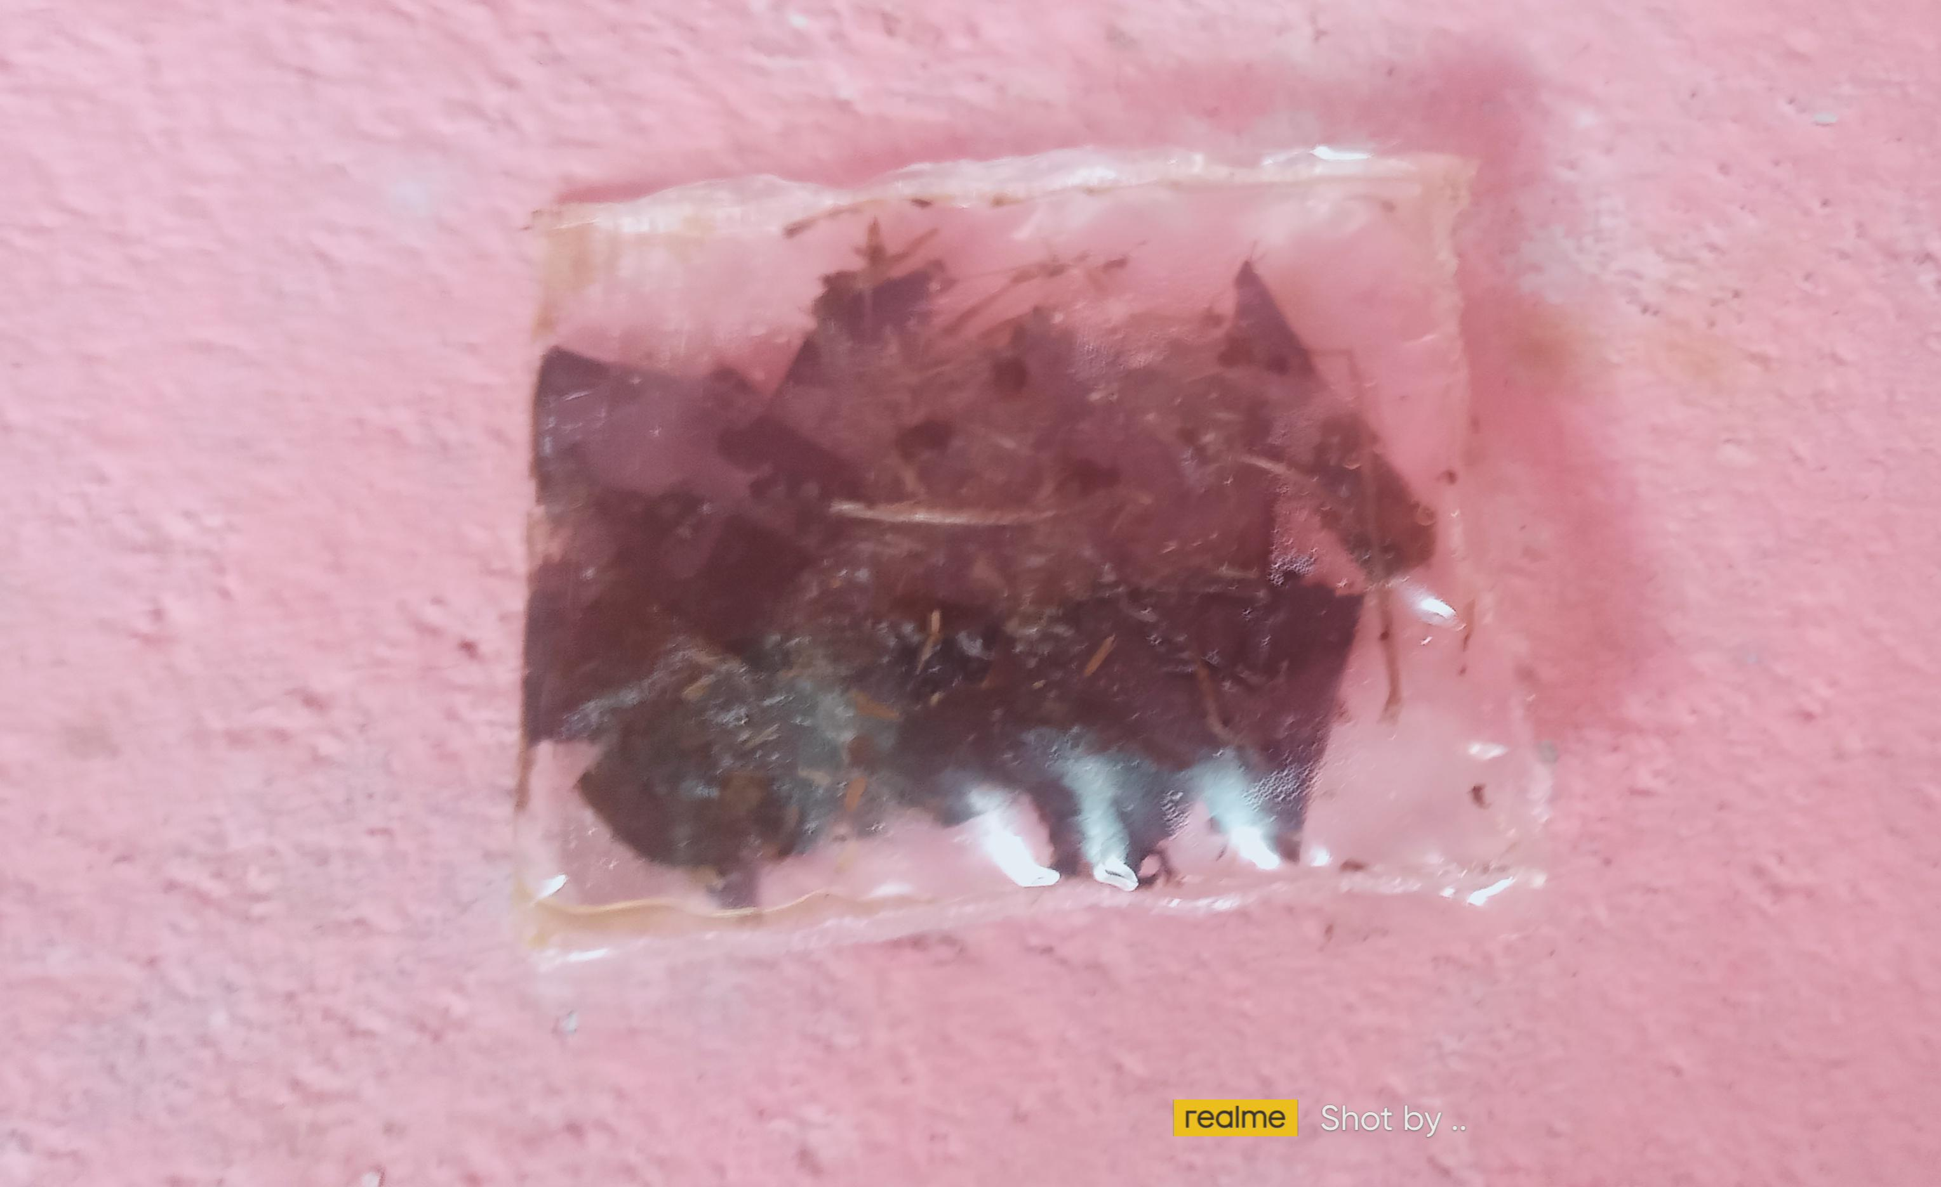
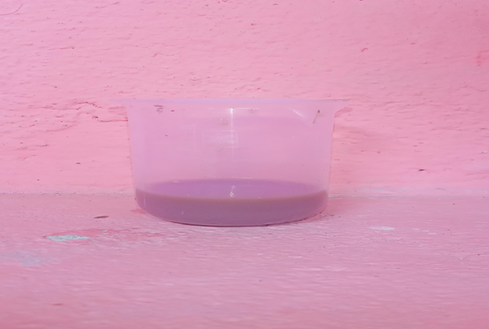
Step 7: Finally, liquid and solid particles are separated. It rich in NPK. It can be used as a fertilizer (liquid and solid) in field.
Fig: solid Fertilizer
Fig: liquid fertilizer

Slide 12
Basic Data:
For Solid Fertilizer:-
Sl. no | Nitrogen (%) | Phosphorus (%) | Potassium(%)
Rice | 3.95 | 4.78 | 6.75
Mustard Oil | 6.13 | 11.5 | 15.7
Banana | 9.56 | 12 .17 | 13.39
Nutrient quantity test in Assam Agricultural University, Jorhat

Slide 13
For liquid Fertilizer:
Sl.no | Nitrogen (%) | Phosphorus (%) | Potassium(%)
Rice | 4.87 | 5.24 | 7.95
Mustard Oil | 7.05 | 13.58 | 16.25
Banana | 11.09 | 15.47 | 17.33
Nutrient quantity test in Assam Agricultural University, Jorhat

Slide 14
SOME BASIC CONDITIONS:
Agricultural waste first dry properly with help of sun light .
Water should be free from iron, Manganese, Turbidity.
Spray culture water three times for complete decomposition of agricultural waste.
Spray water temperature must be 100⁰C.
Name | Days
Rice | 40 days
Mustard oil | 30 days
Banana | 20-25 days
Other plants | 15 -30 days

Slide 15
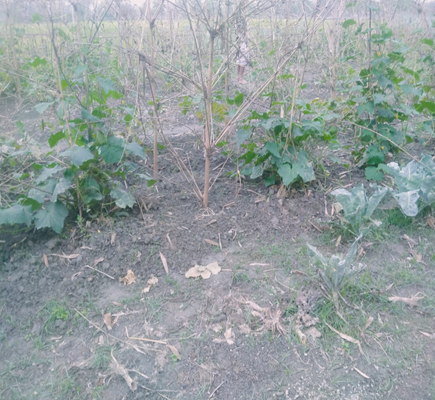
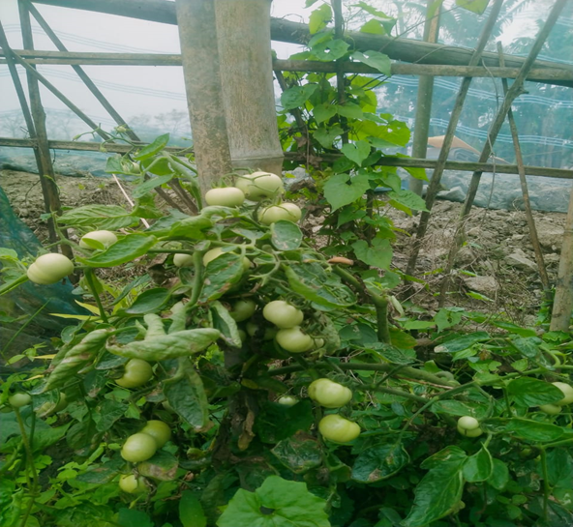
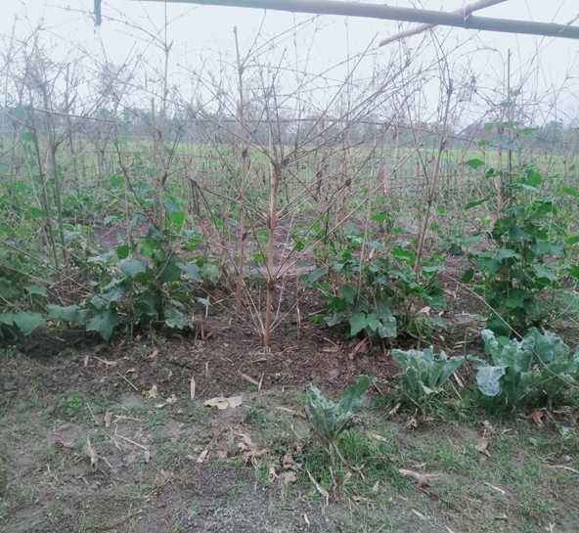
Fertilizer test in field:

Slide 16
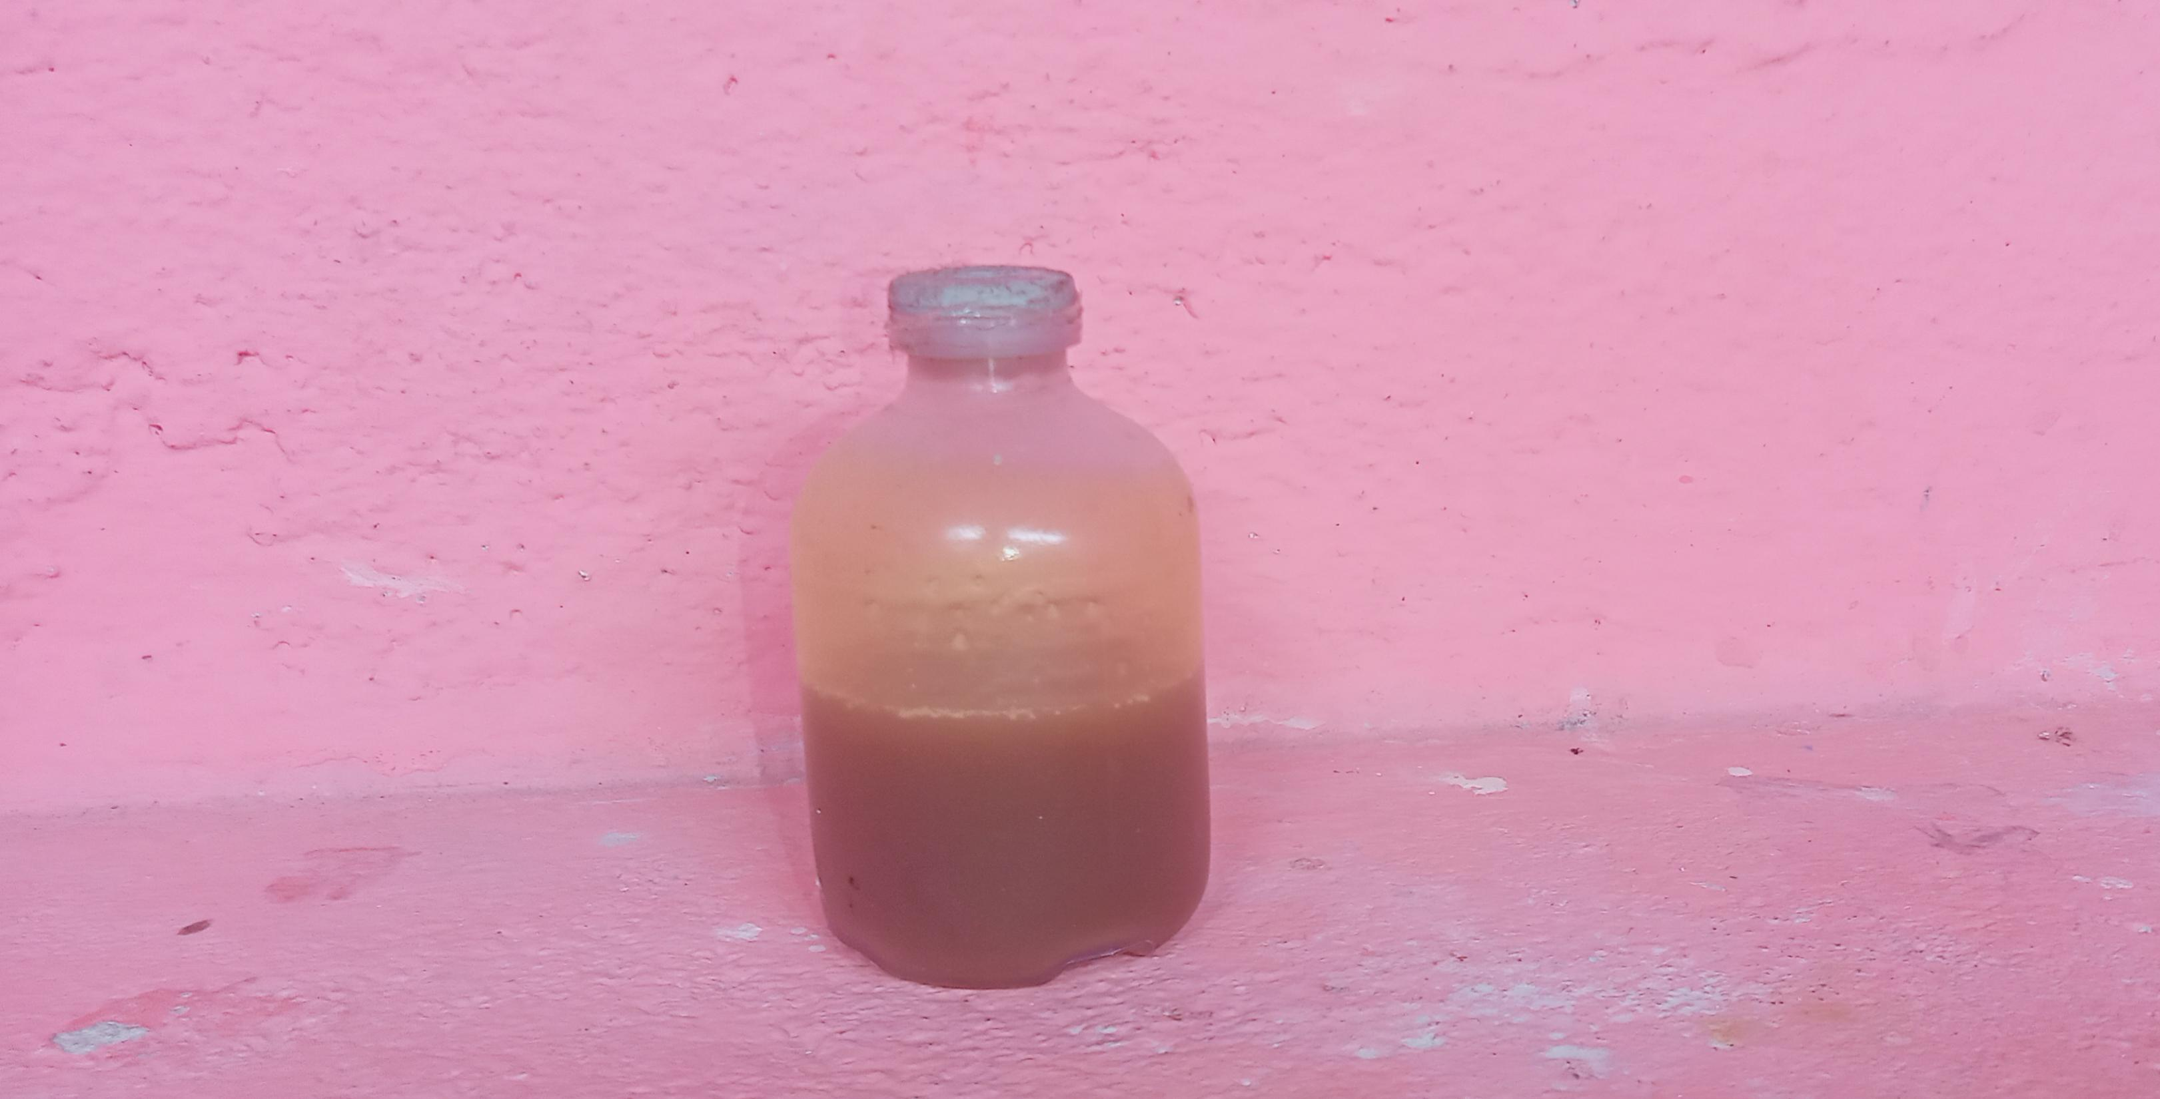
Our Fungus Nutrient…
It is developed for use as a organic nutrient to grow the fungus in the Decomposition technique.
Because normal nutrient not suitable for the fungus proper growth in this technique.
It is prepared from a specific agriculture waste plant juice using a special method.
It contains nutrients needed for fungal growth.
Chemical free
Suitable for fungus
Fig: Fungus nutrient

Slide 17
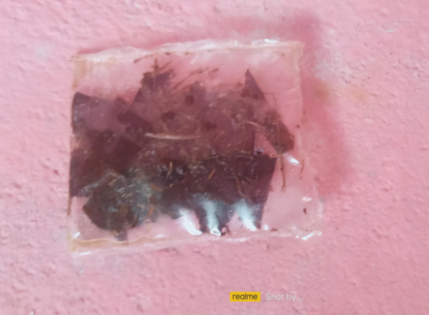
INDUSTRY PLANE
This technique can be used in industrial form.
where solid and liquid particles are obtained as products.
Organic fertilizer can be prepared from these solid particles. Ethanol can be prepared from liquid particles by using some specific method.
To use this technique in industrial form, we need a decomposition camber, a sterilization tank, distillation Tank and 10 KW/Day electricity.
When this technique is used in industrial form, the time of Agri waste decomposition is reduced by 75% compared to normal technique.(Time required only 7-10 days)
Fig: Solid Fertilizer
Fig : Liquid particle

Slide 18
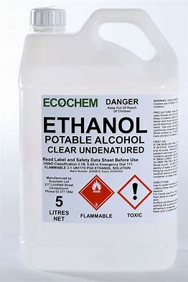
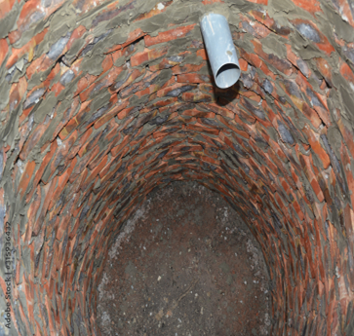
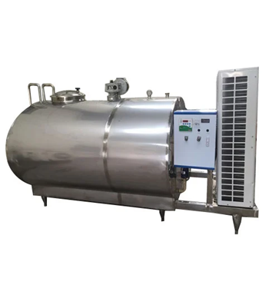
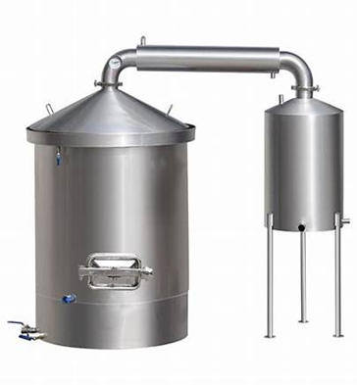
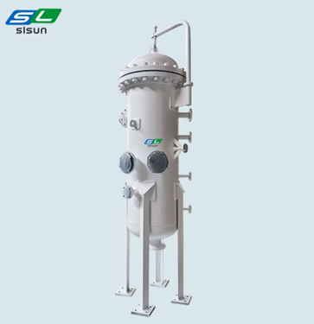
Our USP…Novel Bioethanol & Bio-economy
Culture Liquid
..
.
Mucor Fugus
Sterilization tank
Agriculture Waste
.
.
Ethanol
Distillation
Filtration tank

Slide 19
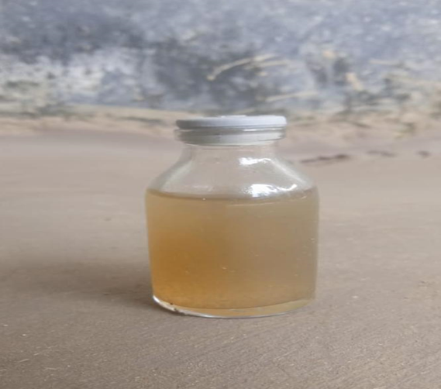
Quantitative requirements:
Basis: 10 litter Ethanol
Agriculture waste: 25 kg
Water: 5 litters
Manpower: 5
Power: 10 kw
(b) Plant capacities:- 30-40 litters per day
Fig : Ethanol

Slide 20
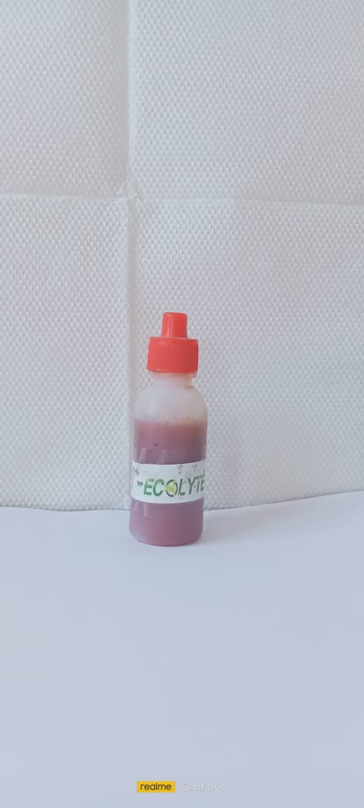
Our Eco E Cell….
To solve the battery pollution , we developed a Eco-friendly, chemical free and pollution free primary cell.
First, we developed an electrolyte with the help of a decompose Agri waste particle by using a specific method .
Then we developed a primary cell with the help of this electrolyte. Where we use Zinc and carbon rod as electrode in the cell.
Eco E cell will produce 1.5 volt .
It can be converted into 3v,6v and 9v battery with the help of series connection.
It can be used in LED lamp, LED bulbs, touch light, watch and remote etc.
It remains in operation for about 1-1.5years.
Batter for lighting facilities.
Fig: Eco E Cell
Fig: Chemical free Electrolyte

Slide 21
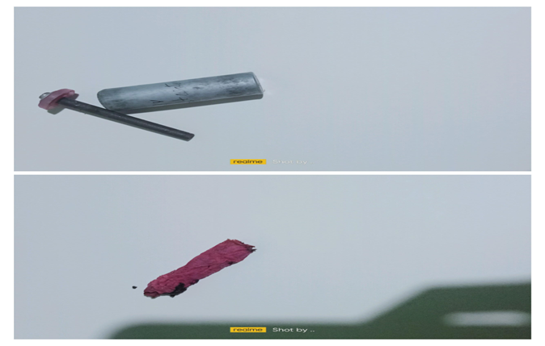
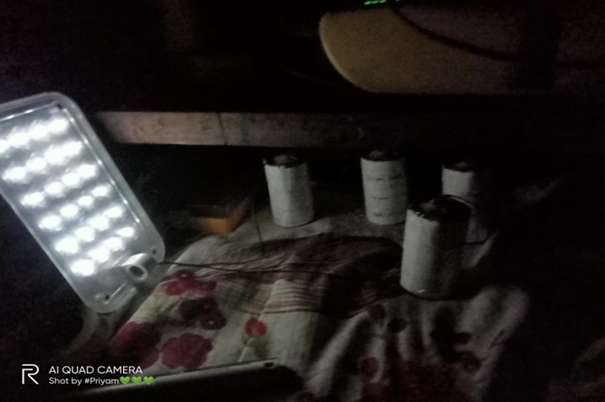
Advantage:
Pollution free and chemical free
Long – lasting either then normal primary cell
Cost – cutting
Easily Recyclable and Reusable.
It can be easily recycled without any help of machine.
It is better for used in the purpose of lighting facilities .
When the voltage level in the cell decreases, a few drops of electrolyte are then added to the cell to increase the voltage again.
Fig: Eco E Cell Recycle parts
Fig: Eco E Cell working activity

Slide 22


Slide 23
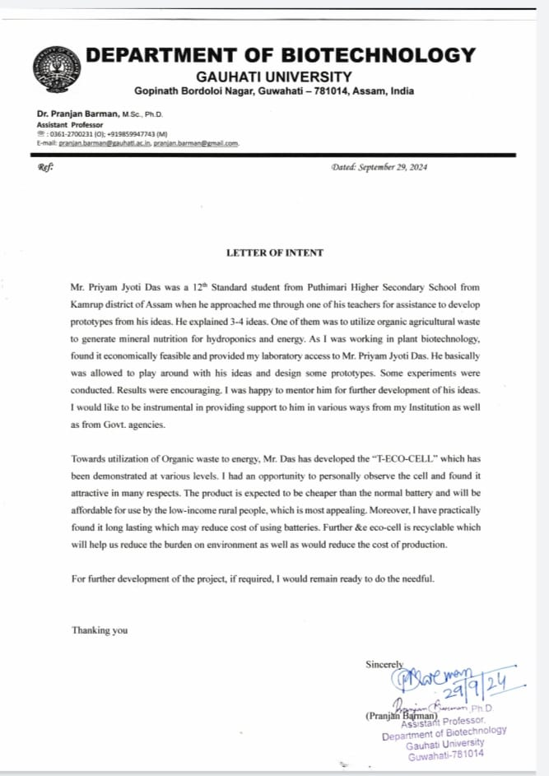
Our Patent Details and LOI
Apply Date: 31/11/2021
Title of Work: T Eco Cell
Ref. Number: 307P2008
Application Status: Final stage
Apply Date: 31/11/2021
Title of Work: Nutrient
Ref. Number: 338P2106
Application Status: Final stage
Apply Date: 28/08/2025
Title of Work: Ethanol Production process
Application Status: First stage

Slide 24






Impact
Environmental Impact
Social Impact
Economic Impact
40%
Reduce Air Pollution
Renewable Source
of Energy
Growth of
local market
80%
Reduce Soil
Pollution
Promote
Organic Farming
Farmers
Economically
Benefitted
70%
30%
Save Water
Promote
Sustainability
Reduce fertilizer price

Slide 25
THANK YOU
hemta931@gmail.com

